Slide 1
Foundations of Full Stack Web Development
Dr Govindha Ramaiah Yeluripati

Slide 2
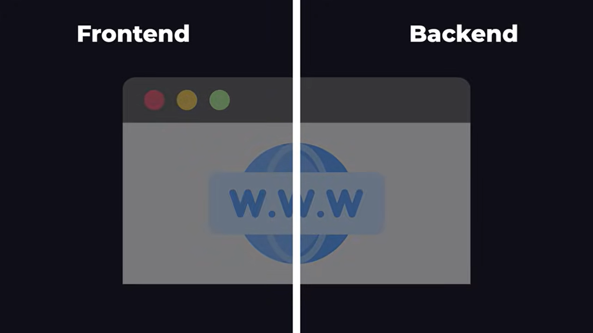
Your Web App
A Web App can be split into two parts: Frontend and Backend

Slide 3
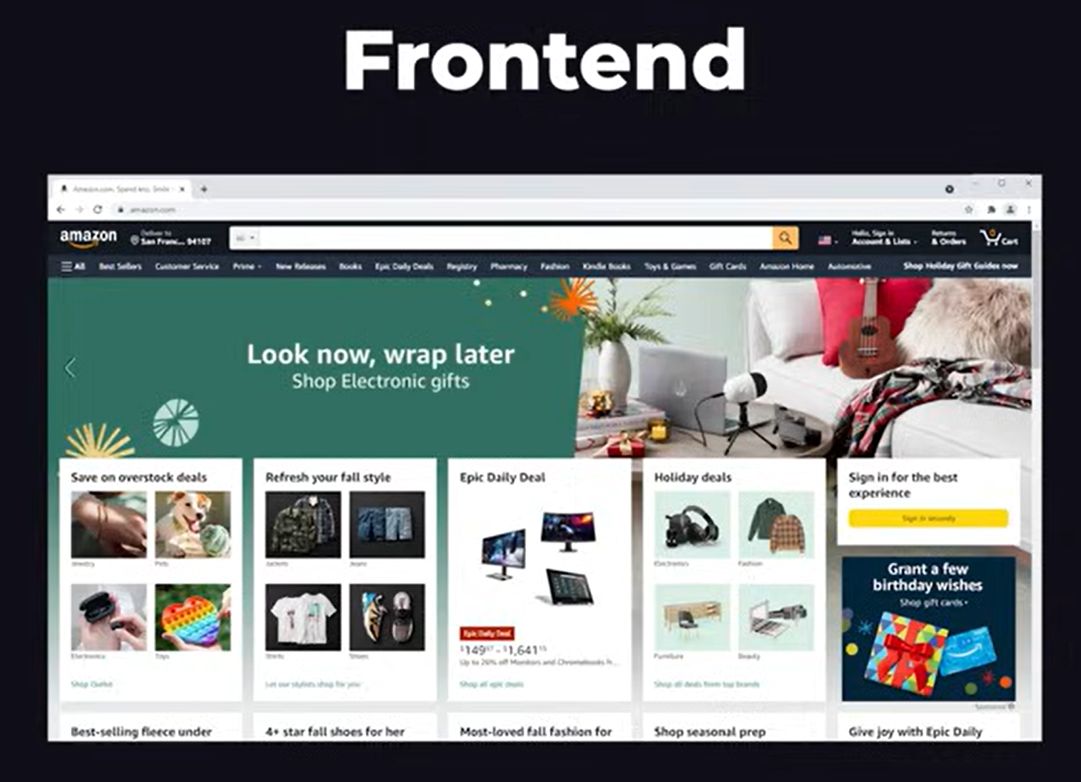
Frontend
The frontend is all the visual stuff seen on the web page with which a user interacts.

Slide 4
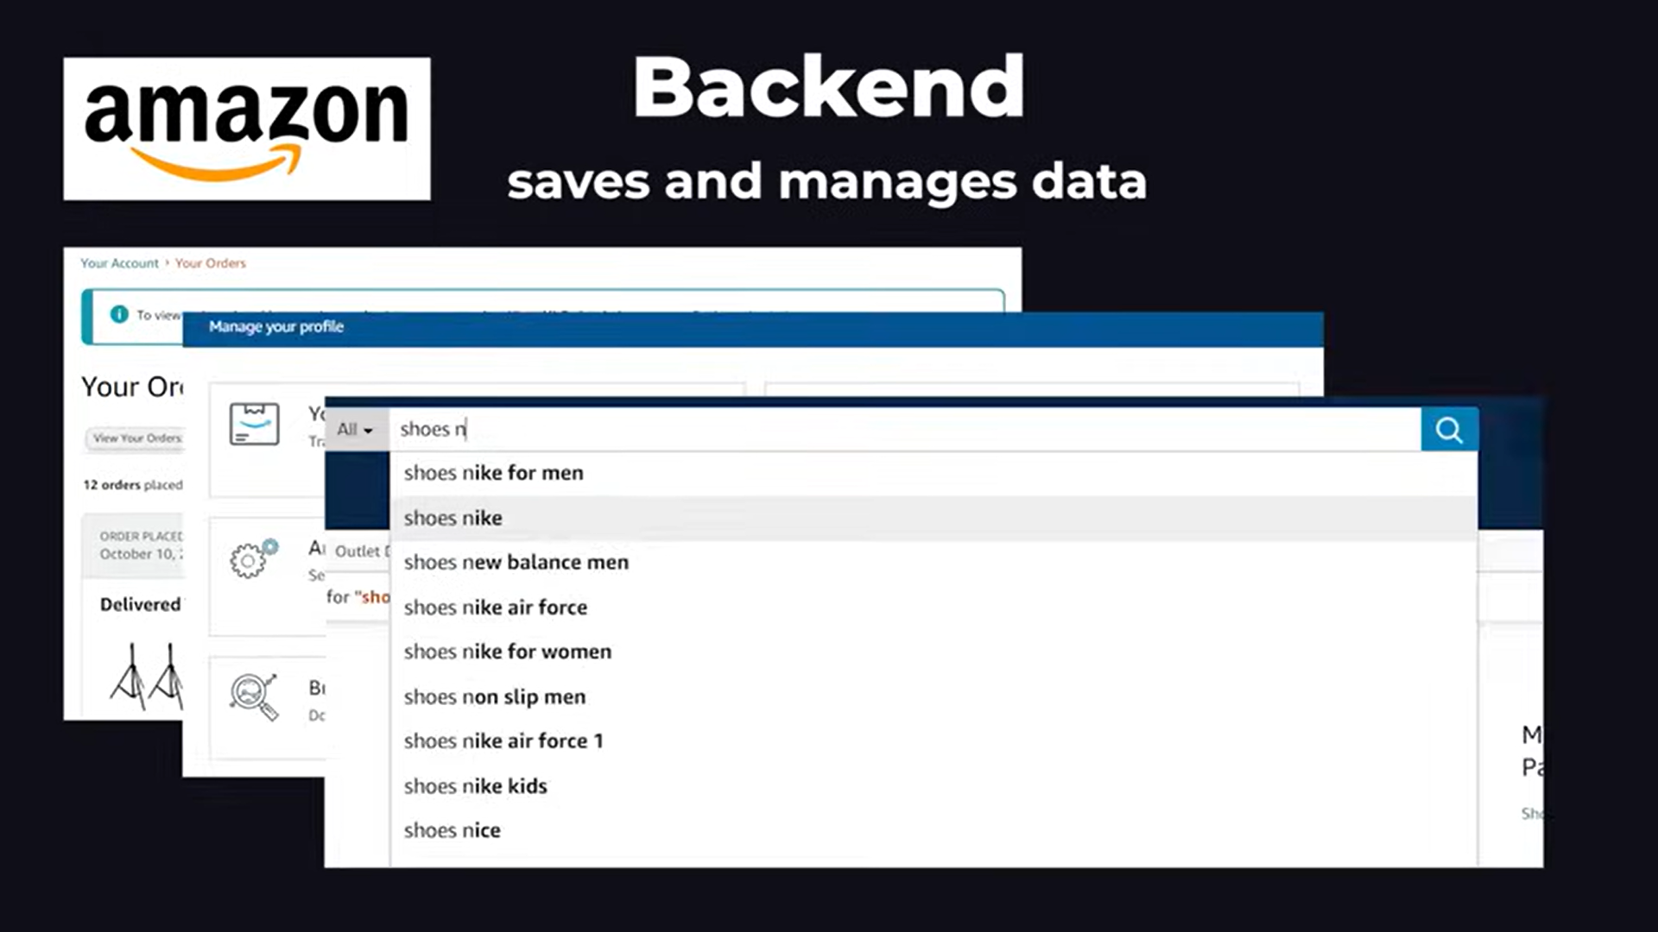
Backend
The backend is what saves and manages your data (e.g., order history, profile info, search results etc. on Amazon.com).

Slide 5
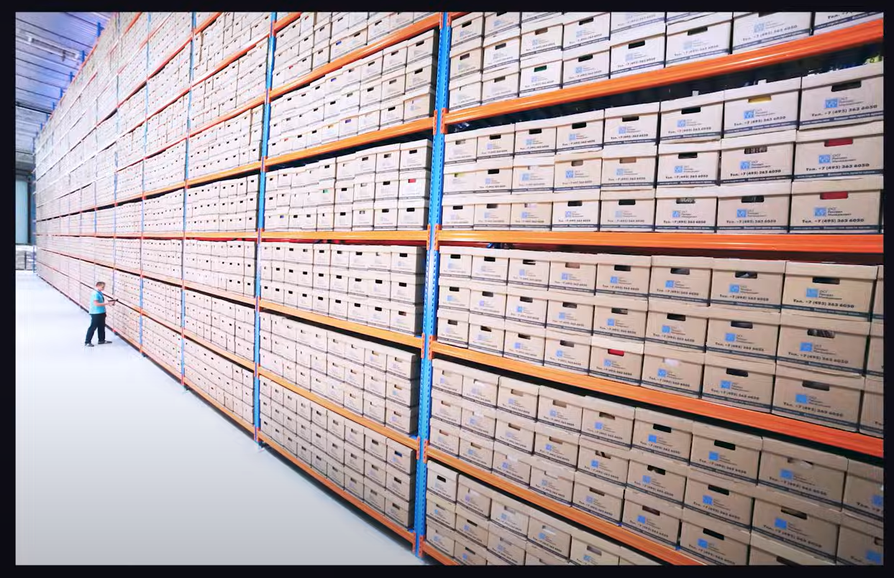

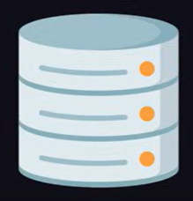
The Database
The data that is managed by the backend is stored in a database, which is a piece of software that runs on a different computer.

Slide 6
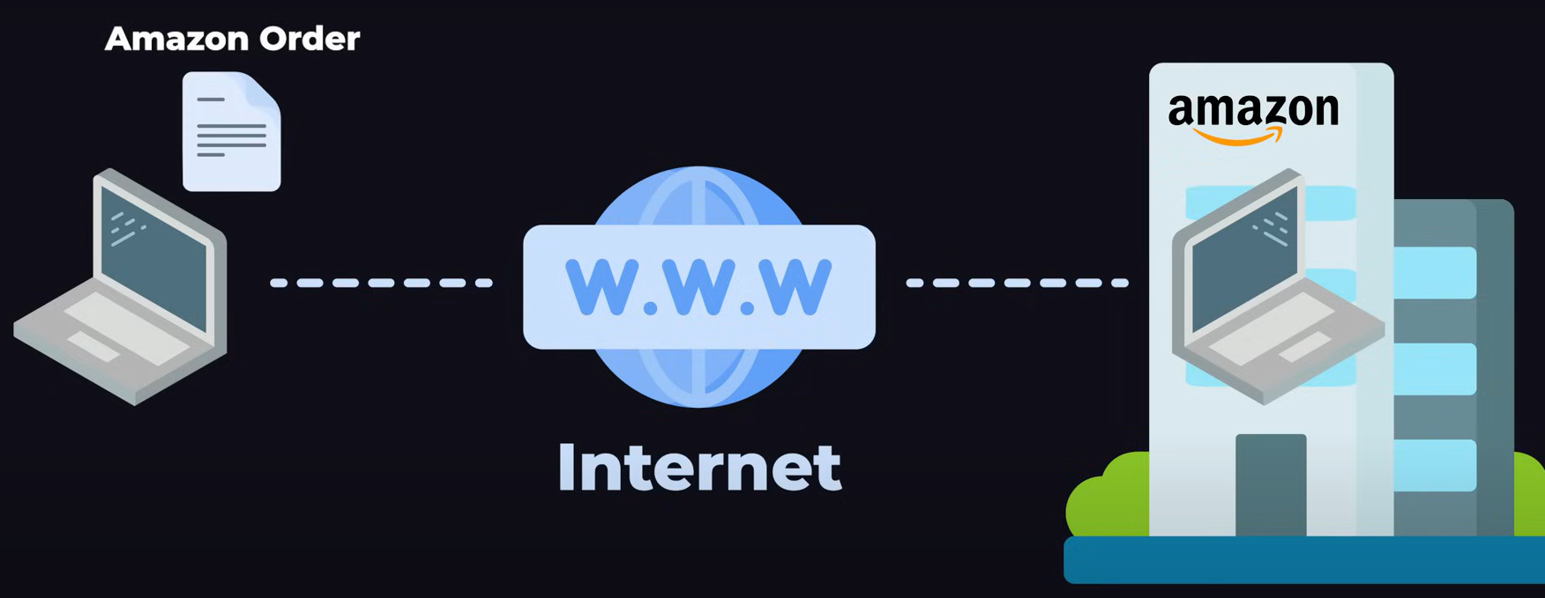
Communication
The communication between the frontend and backend is facilitated by specific protocols (e.g. HTTP/HTTPS) and technologies (e.g. APIs, AJAX) that work over the Internet.
Example: User's computer sends an order to the computer located in the Amazon's building.

Slide 7
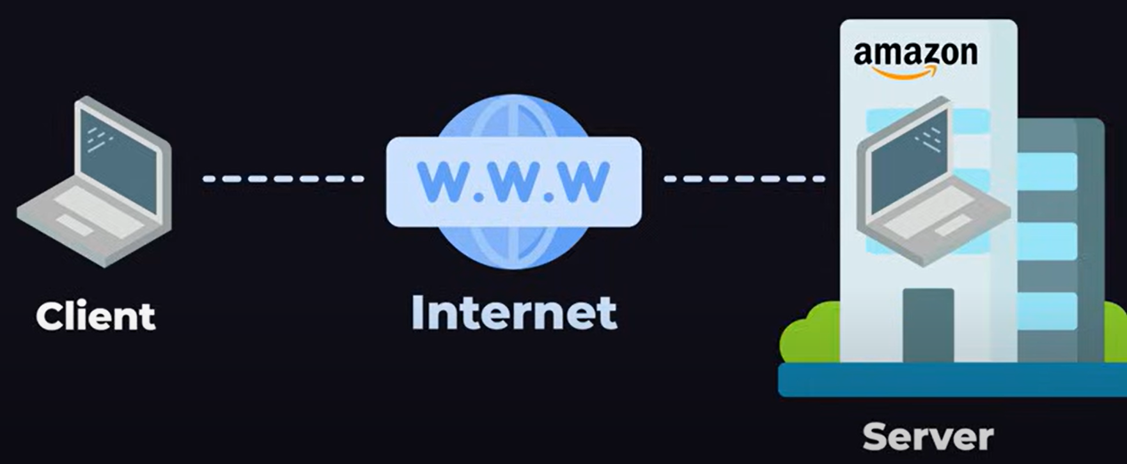
Dominant terms: Client and Server
The computer that sends the message requesting something is called the CLIENT and the computer that receives the message and responds is called the SERVER.

Slide 8
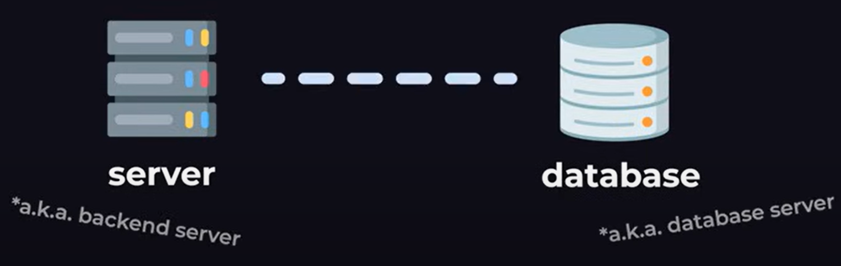
Backend Server and Database Server
The computer that runs the server-side code that processes user requests, handles databases, executes application logic, manages user authentication, etc., is called the backend server.
The computer that contains the database is the database server.

Slide 9
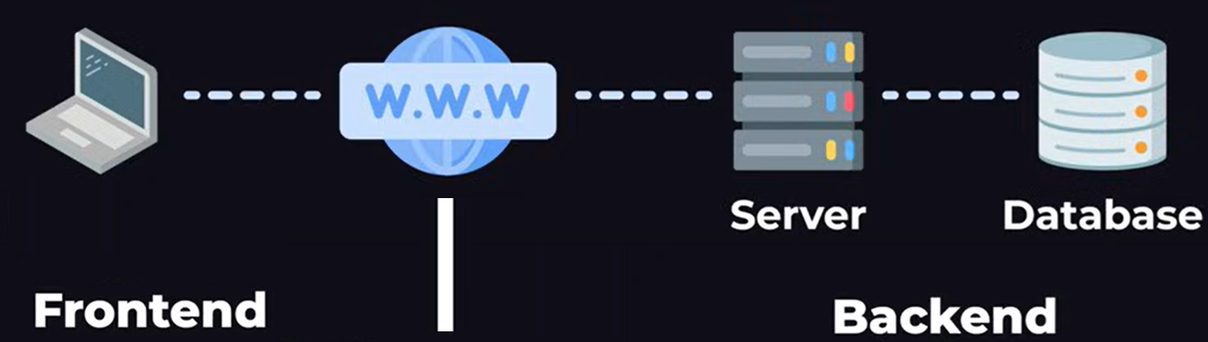
Full Stack: Our Focus Now
(HTML, CSS, JavaScript)
(PHP/Node.js/Python, MySQL/MongoDB)

Slide 10
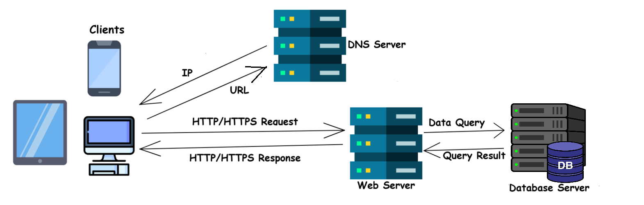
Web (WWW) architecture
Web Architecture is the structural design of the World Wide Web.
It defines how web components such as servers, clients, and databases interact with each other through standardized protocols and frameworks like HTTP/HTTPS, DNS, URL structures, and the basic client-server interaction model that enables websites to function.

Slide 11
Web architecture
Summary of the communication Flow:
Clients → Send URL Request.
DNS → Resolves URL to IP.
Clients → Send HTTP/HTTPS Request using IP.
Web Server → Receives and Processes the Request.
Web Server → Queries Database (if needed).
Database → Returns Data to Web Server.
Web Server → Sends Data/HTML Response to Client.

Slide 12
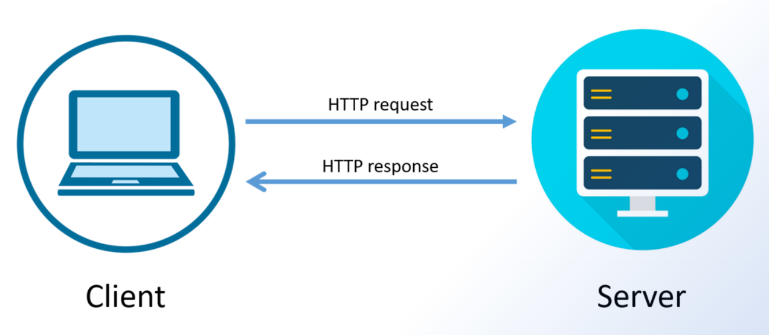
Request-Response Cycle
A series of interactions in which a client sends a request to a server, and the server processes the request and returns an appropriate response to the client.
This model forms the backbone of client-server communication on the web.

Slide 13
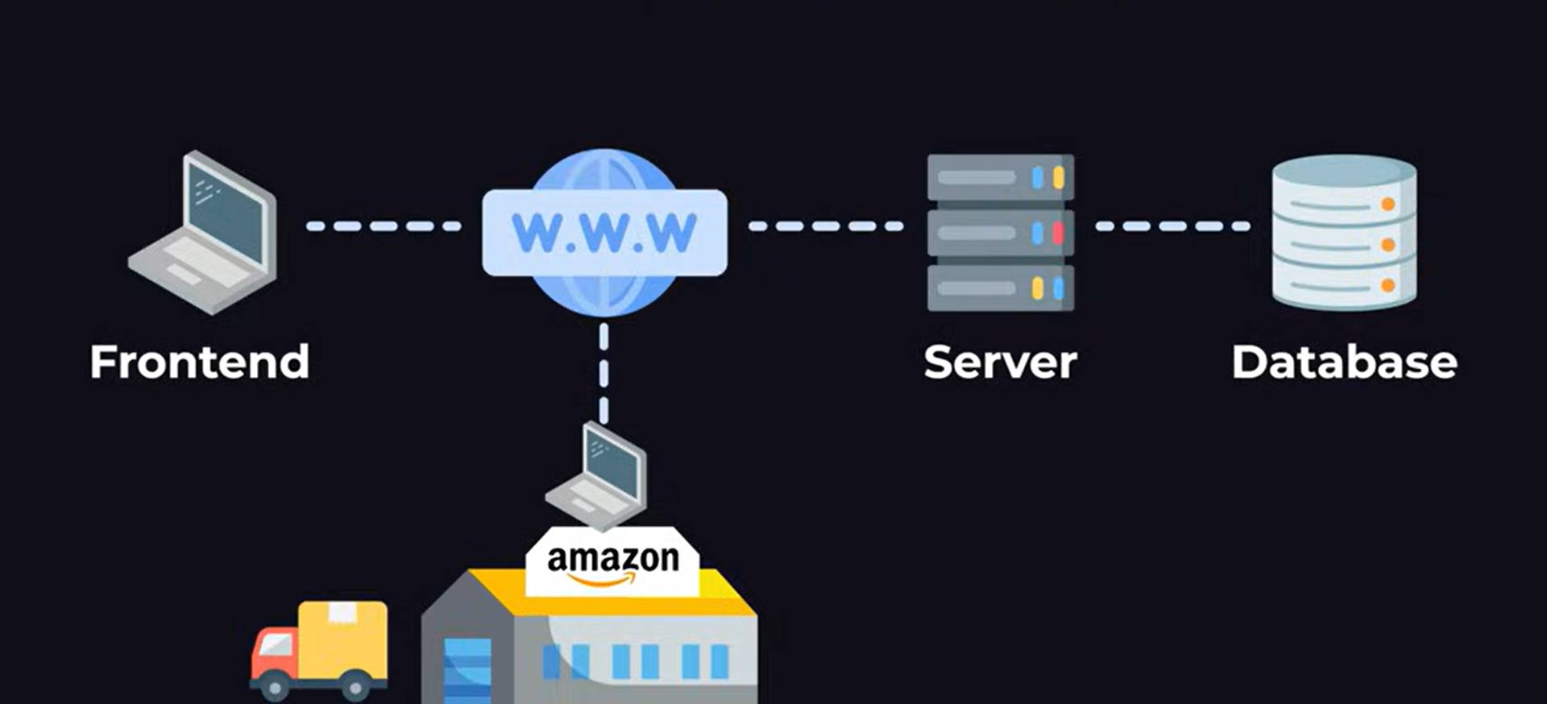
A Typical Practical Scenario
Order Created
Order Stored
Order Request
→
Order Confirmation Response
← ←
Warehouse

Slide 14
A Typical Practical Scenario
Fetch Order →
Send Order
Back
← Order
Order Details
Get Order
Order Shipped
Warehouse

Slide 15
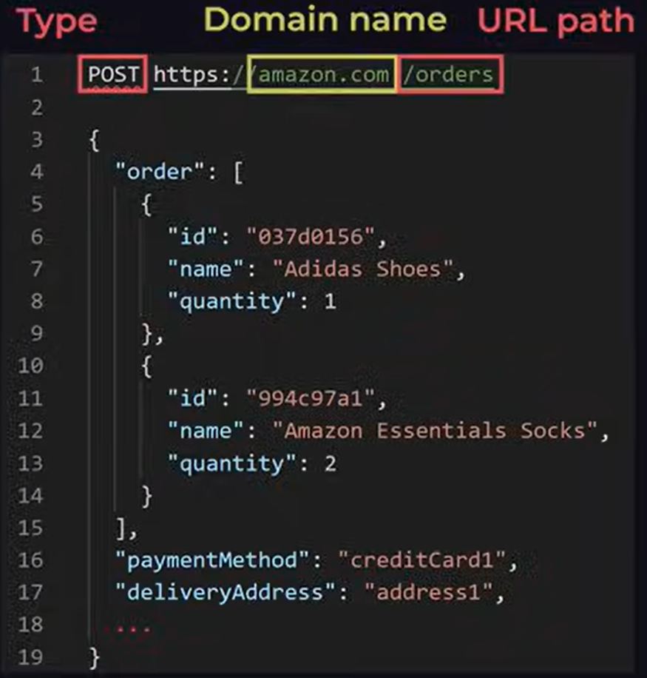
What is inside a Request

Slide 16
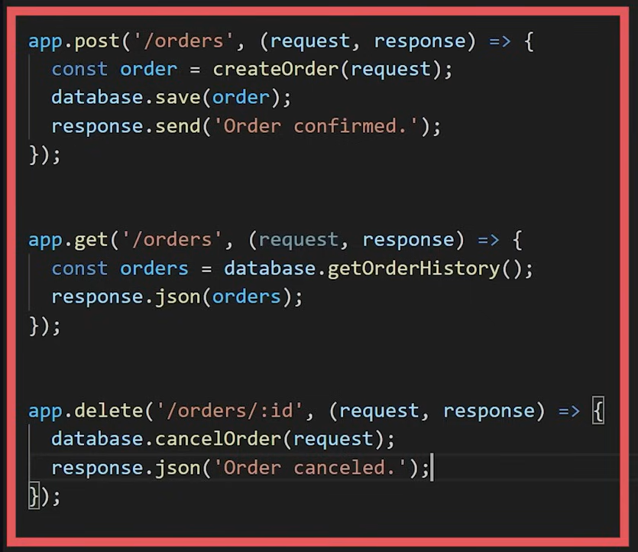
The API
In the backend, we use our programming language and backend framework to define what type of requests are allowed and how to handle them.
The list of all the different types of request the backend allows is called the Application programming Interface or in short API

Slide 17
API Usage Scenarios
Between Frontend and Backend: In most web applications, the frontend (the user interface and client-side code) interacts with the backend (server-side logic and databases) using APIs.
In this case, APIs serve as an intermediary allowing the frontend to make HTTP requests (like GET, POST, PUT, DELETE) to the backend to perform tasks such as retrieving data, submitting forms, or executing business logic.
Example: A frontend web page making a POST request to save a new user's information to a database via a REST API hosted on the backend server.

Slide 18
API Usage Scenarios
Between Two Different Applications: APIs can also act as a bridge between two separate applications or services, enabling them to exchange data or functionality.
This is common in microservices architecture or when integrating third-party services (like payment gateways, social media login features, or cloud storage services).
Example: A web app integrating with a payment processing service like Stripe or PayPal using their API to handle financial transactions without directly managing the payment processing logic.

Slide 19
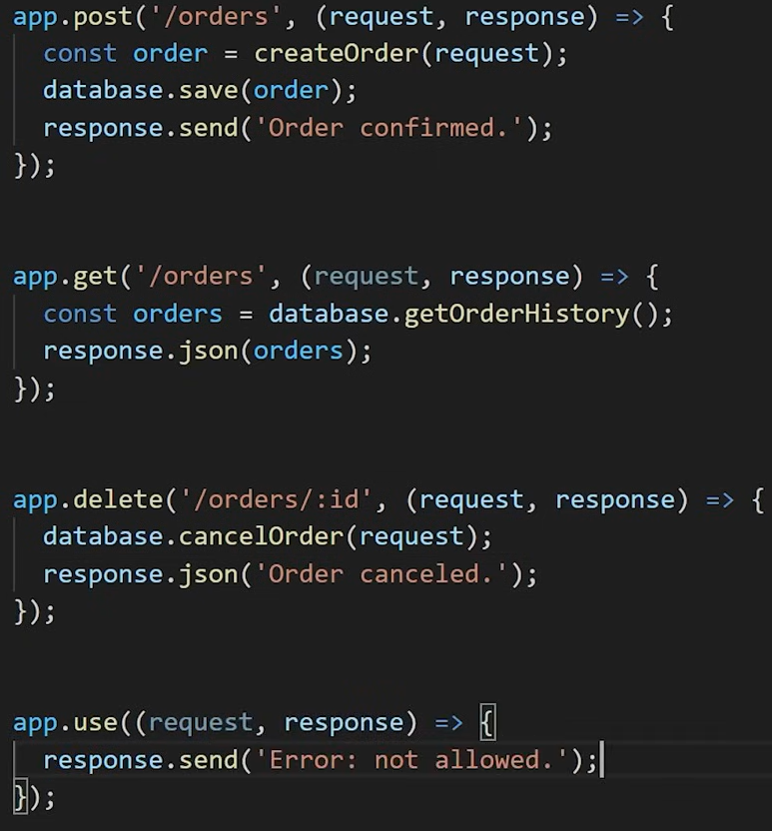
The API
If a request that is not in the API is sent, the backend can be coded to respond with an ERROR.

Slide 20
Protocol
What is a protocol?
A protocol is a set of rules and standards that define how data is formatted, transmitted, and received in a network.
It establishes guidelines for communication between devices, ensuring that different systems can understand and interpret the data they exchange.

Slide 21
Example Protocols
HTTP (Hypertext Transfer Protocol): Defines how web browsers communicate with web servers to fetch web pages and resources.
TCP/IP (Transmission Control Protocol/Internet Protocol): A suite of protocols that form the foundation of the internet, responsible for reliable data transfer and routing between devices.
FTP (File Transfer Protocol): Rules for transferring files between computers over a network.

Slide 22
Example Protocols
SMTP (Simple Mail Transfer Protocol): Defines how email messages are sent between email servers.
DNS (Domain Name System): Protocol for translating human-readable domain names (e.g., google.com) into IP addresses (e.g., 142.251.37.174).
WebSocket Protocol: Provides full-duplex communication channels over a single TCP connection for real-time applications.

Slide 23
HTTP
HTTP stands for Hypertext Transfer Protocol.
HTTP is the foundational protocol for the web, used for communication between a client (like a browser) and a server.
It is based on Request-Response model.

Slide 24
HTTP
Common HTTP Methods:
GET : Retrieve data from a server e.g., fetch a webpage or resource
POST : Send data to the server to create a resource e.g., submit a form
PUT : Update an existing resource or create one if it doesn't exist.
DELETE : Remove a resource from the server.
PATCH : Partially update a resource.

Slide 25
HTTP
HTTP Status Codes: Standardized codes sent by servers in response to a client’s request.
1xx (Informational) : Request received and continuing process e.g., 100 Continue, 101 Switching protocols
2xx (Success) : Request successfully processed
e.g., 200 OK, 201 Created
3xx (Redirection) : Further action required to complete the request
e.g., 301 Moved Permanently, 302 Found
4xx (Client Error) : There is an issue with the request
e.g., 400 Bad Request, 401 Unauthorized, 404 Not Found
5xx (Server Error) : There is an issue with the server e.g., 500 Internal Server Error, 503 Service Unavailable

Slide 26
HTTP
HTTP Headers: Key-value pairs that provide additional information about an HTTP request or response. Headers can include information about the data being sent, client/server capabilities, authentication, caching policies, and more.
Request Headers : Provide additional info about the request
e.g., Content-Type: application/json
Response Headers : Provide info about the response e.g., Content-Length: 348
Common Headers : Content-Type, Authorization, Accept, User-Agent

Slide 27
HTTP: Request-Response Structure
Request consists of:
Request Line : Method + URL + HTTP version
e.g., GET /index.html HTTP/1.1
Headers : Key-value pairs
e.g., Host: example.com
Body (optional) : Data sent with the request (used in POST, PUT)
Response consists of:
Status Line : HTTP version + status code + status message e.g., HTTP/1.1 200 OK
Headers : Key-value pairs e.g., Content-Type: text/html
Body (optional) : Data sent back to the client

Slide 28
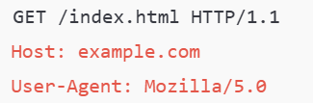
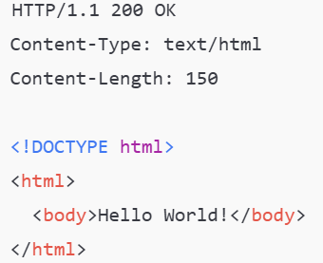
Example HTTP Request and Response
Request:
Response:

Slide 29
HTTP: Key Concepts
Statelessness: HTTP is stateless, meaning each request is independent and carries all the necessary information.
Connection Management: HTTP/1.1 supports persistent connections, while HTTP/2 and HTTP/3 introduce multiplexing for efficiency.
HTTPS: Secure version of HTTP, using SSL/TLS for encryption.

Slide 30
REST and RESTful Design
REST stands for Representational State Transfer
It was defined by Roy Fielding in his doctoral dissertation in the year 2000 as an architectural style for distributed systems (Networked Applications).
It uses a stateless, client-server communication model and operates over HTTP commonly.

Slide 31
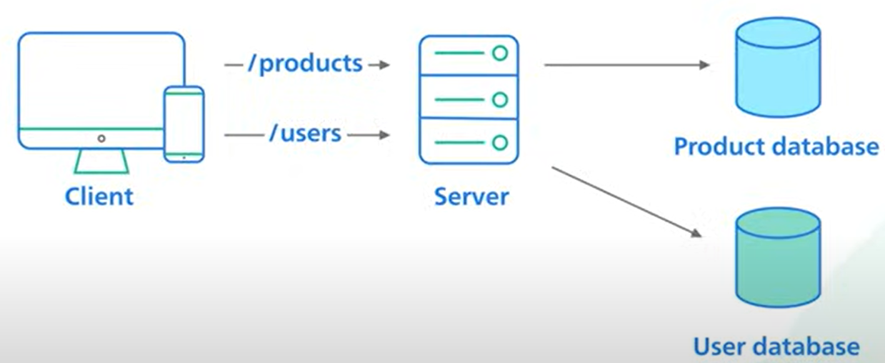
REST and RESTful Design
Many server-side applications follow the REST architectural style
In REST, APIs are designed around resources (e.g., users, orders, or products) and the standard HTTP methods are used to perform operations on those resources.
Examples:
GET /users: Fetch a list of users
POST /users: Create a new user
PUT /users/1: Update the user with ID 1
DELETE /users/1: Delete the user with ID 1
Fig Source: Click here

Slide 32
REST Convention for Request: Example

Slide 33
REST and RESTful API
REST is a set of principles and constraints that define how web services should be designed and communicate over a network.
It is not a standard, a protocol, or a framework, but a guiding philosophy that influences the way systems are structured and interact with each other.
A RESTful API is an API that adheres to the principles and constraints of REST.
The sample API on Slide 20 is an example
But, What are they?

Slide 34
Other API Conventions
GraphQL is a query language and runtime for APIs, allowing clients to define the exact data they need.
RPC is an approach for remote procedure calls, where the focus is on calling remote functions rather than interacting with resources.
Common Types: JSON-RPC, XML-RPC, gRPC by Google

Slide 35
Web Hosting
Web hosting is a service that enables individuals and organizations to publish a website or web application on the internet.
Web hosting provides the technology and resources required for the website to be accessible globally.
For personal projects and portfolios, static site hosting with platforms like GitHub Pages or Netlify is ideal.
Several CMSs (such as WordPress, Wix, Squarespace etc.) normally provide fully managed hosting services.

Slide 36
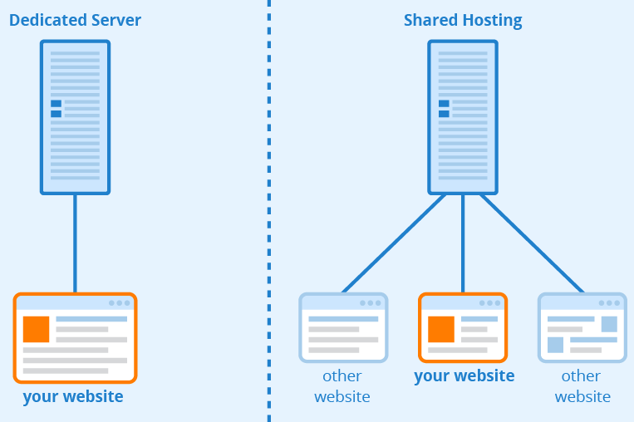
Web Hosting: Common Types
Self-Hosting: For advanced users who prefer to maintain their own servers using tools like Nginx or Apache.
Shared Hosting: Where multiple websites share the same server resources. Ideal for small websites and beginners.
Dedicated Hosting: An entire physical server is dedicated to one user. Suitable for large websites with heavy traffic.

Slide 37
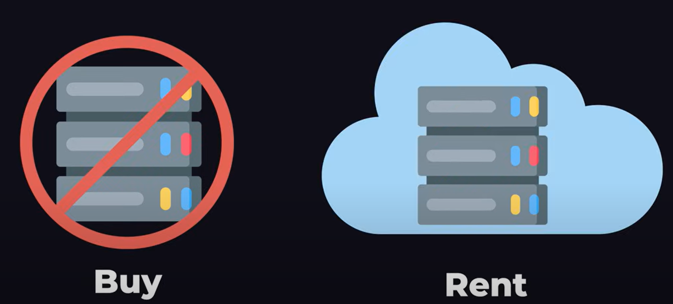

Web Hosting: Common Types
Cloud hosting: Required computing resources are rented from Cloud Computing companies like Microsoft, Amazon and Google.

Slide 38
Web Hosting: Common Types
Serverless Hosting: A cloud computing model where one don’t have to manage physical servers or traditional infrastructure.
Code gets executed in response to events, and the cloud provider takes care of provisioning and scaling the required resources automatically.
This model is typically implemented using services like AWS Lambda, Azure Functions, or Google Cloud Functions.
Despite the name, "serverless" doesn't mean there are no servers involved. It simply means that the developer don’t need to worry about server management, scaling, or maintenance. The cloud provider handles it all.

Slide 39
Thank you
Questions???
Dr Govindha

